Slide 1

Commit Changes
Source Control
Build
Deploy
Build Code and run unit tests
Deploy Application

Slide 2
Pipeline
Source Stage
Build Stage
Artifact
Transition
Action
Action 1
Action 2

Slide 3
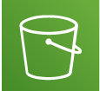
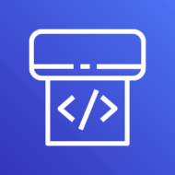
Code.zip
Source S3 Bucket
AWS CodePipeline
Production S3 Bucket
[Static website Hosting]

Slide 4
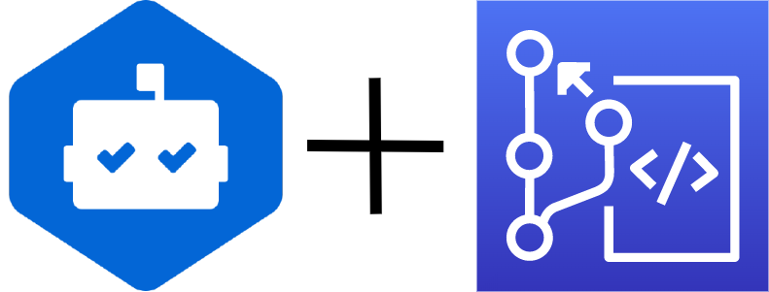
Code.zip
AWS CodePipeline
Production S3 Bucket
AWS CodeCommit
[Static website Hosting]

Slide 5
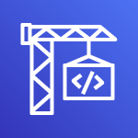
sz
AWS CodePipeline
Source Artifact
Build Artifact
AWS CodeBuild
AWS CodeCommit
Production S3 Bucket

Slide 6
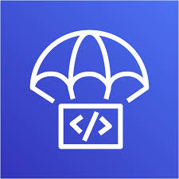

Download Build Artifacts
EC2 need IAM role to access bucket
Check for new deployment
AWS CodeDeploy
Amazon EC2

Slide 7
Check for new deployments
AWS CodeDeploy
Amazon EC2

Slide 8
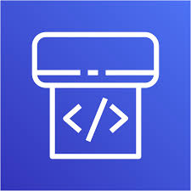
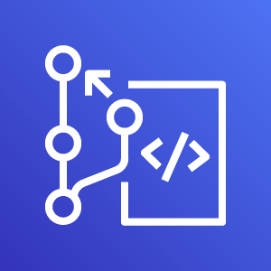
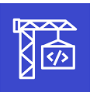
AWS Code Pipeline
Source Artifact
Build Artifact
AWS CodeCommit
AWS CodeBuild
AWS CodeDeploy
Amazon EC2

